Slide 1
R Session 5
Recap confounding and case control bias, measurement error/bias, likelihood theory quickly

Slide 2
Stratifying to identify potential confounders
Stratifying allows us to separately investigate the association between exposure and outcome within the levels of a confounder – thereby removing the effect of that confounder and showing how much of the association is explained by that confounder.
If the association differs by levels of confounder that suggests that there is something more than just the two explanatory variables at play – the exposure and confounder combine to produce a greater effect than their independent effects.

Slide 3
Bias in case control studies
Selection bias
Exposed cases may be more willing to take place in a study – hence the self fulfilling effort of recruitment. This exposure status affecting enrolment won’t happen in the controls.
Exposed cases are more likely to be selected than non-exposed – see household and hospital data.
Try and not select on exposure status.
Missing data bias
Is the missing data correlated with the exposure or outcome?
If so, don’t adjust for it.
If the missingness is truly random then you can use multiple imputation to ‘fill in the gaps’

Slide 4
Information Bias – Measurement Error
Can happen with any kind of data, and be differential or non-differential.
Causes
Poor Design!!!!!!!!!!!!!!!!!!
CHECK YOUR QUESTIONNAIRE QUESTIONS TO MAKE SURE THEY DON’T DISCRIMINATE BASED ON EXPOSURE OR OUTCOME STATUS
Poorly calibrated instruments (any assessment scale)
Poor instructions to field workers
Could be detail in your protocol, or training of observers in interpretation or testing
Actually telling them to treat controls the same as cases!

Slide 5
Measurement Error cont.
Poor execution
Failure to follow protocol/read instructions/handle specimens correctly
Recall bias
Failure to remember exposure
Proxy respondents may not know/may be influenced by public knowledge
CONFUSING QUESTIONS
Have you ever taken painkillers containing codeine?
Errors in data entry and analysis
Late at night, inputting paper records into a database by hand, you miss a box – boom. Frame shift.
Maybe that was a one, or maybe a zero, maybe my finger slipped.

Slide 6
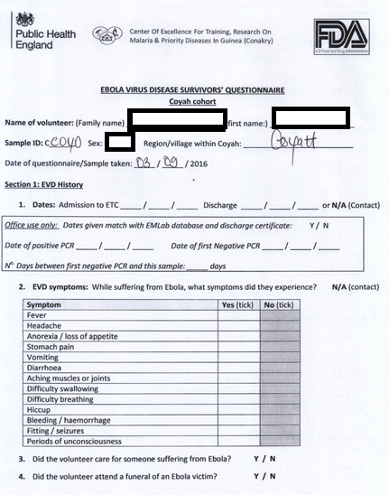
Personal Experience

Slide 7
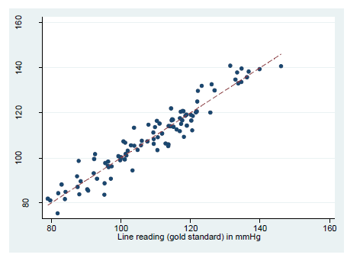
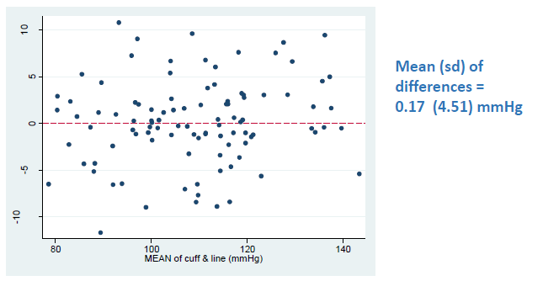
Quantify validity
Continuous variable
Pearson correlation?
NOT ALWAYS USEFUL
If a new method uses systematically lower or higher values than the gold standard then the correlation may still be r=1!!!
Scatter plots of the differences vs the mean to see if there is any change in measurement at the extremes

Slide 8
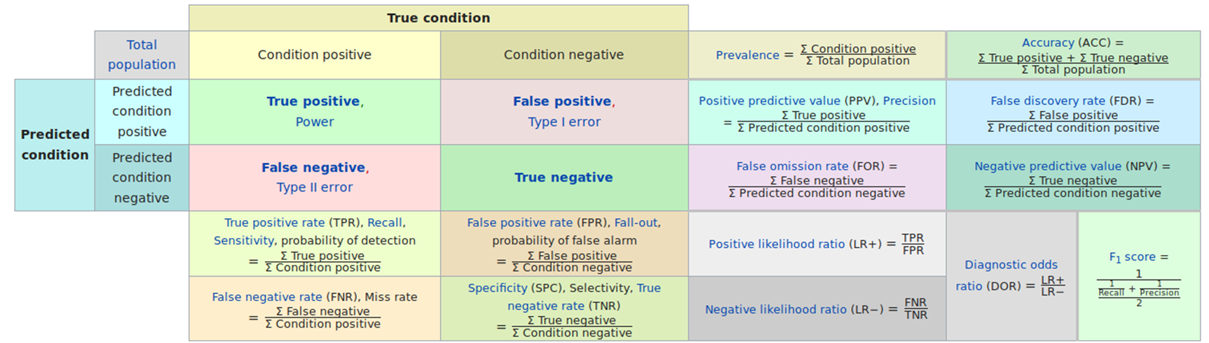
Sensitivity, Specificity, PPV, NPV

Slide 9
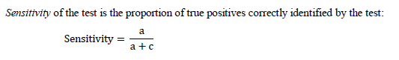
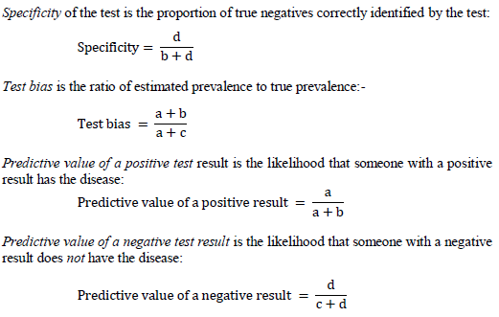
Sensitivity, Specificity, PPV, NPV
An ideal test has high sensitivity (correctly identifies a high proportion of individuals with disease) and high specificity (gives few positive results in individuals without disease).
The predictive value of a test result depends upon the prevalence of the disease. The lower the prevalence, the lower the predictive value of a positive test result.

Slide 10
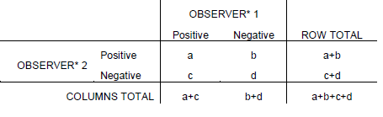
Reliability
Not the same as validity!
Can be divided up into intra- and inter-observer reliability

Slide 11
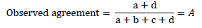
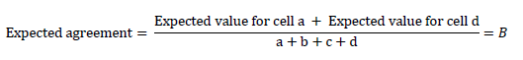
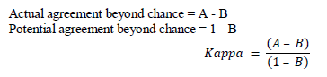
KAPPA
Takes into account the agreement based on chance, and is independent of prevalence of the observed characteristic.

Slide 12
Interpretation of Kappa Statistic
Difficult
1 is perfect agreement
0 is no better than pure chance
Normally above 0.75 is excellent, 0.4-0.75 is fair to good agreement, less than 0.4 is poor to moderate agreement.
More than two outcomes being compared?
Use WEIGHTED Kappa Test
More weight assigned to closer agreements (1 v 2) than large differences (1 v 5)

Slide 13
What does all this mean?
Consider whether your measurement/misclassification is differential or non-differential based on exposure status.
Non-differential USUALLY biases OR/RR towards the null of 1, leading to an underestimation or dilution of effect. (gets tricky when measuring the outcome)
Differential can bias your exposure classification one way or another, and therefore can effect measures of association up, down, or not at all. You have to think it through for each source of bias for each variable, and then make conclusions/change measurement.
Measurement error can’t just be corrected for your study using a validation study in another study and population – the subjects are different and the prevalence of characteristics means they can’t be compared

Slide 14
Likelihood Theory
All statistical analyses are based on probability models – for simple analyses this is not always explicit.
Cohort (fixed interval) = Statistically independent binomial risk distribution π
Cohort (varying interval) = Independent rates of disease λ based on Poisson distribution
Prevalence = Statistically independent binomial risk distribution π
Models allow us to make statements about the value of a parameter (outcome usually) based on past observations (exposures). The measure of the quantify the support provided by a body of data for a particular value of a parameter in a probability model is called likelihood

Slide 15
Likelihood
You can calculate the likelihood by working out how probable the observations would be if the parameter were to have the assumed value.
The concept is that parameter values that make the data more probable are better supported than values which make the data less probable.

Slide 16
Example with binomial probability
Small study – 2 outcomes Failure (F) or Survival (S)
Question: what’s the risk of failure in the population from which this sample was drawn?

Slide 17
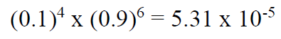
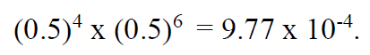
Let’s explore that model you’ve just made.
What’s the probability of each individual outcome, using π ?
What’s the value when we say your π equals 0.1?
0.5?
The probability of this data being true is greater if π is 0.5 than 0.1
What’s the generalised form of this binomial model?

Slide 18
Make this model in R
Create a vector of your probability with a sequence every 0.00001.
Create a second vector with the generalised equation from the last slide (4,6)
Combine these into a tibble
Find the value of pi which correlates to the maximum likelihood value
You can filter by == max(var)
Plot your model with ggplot2

Slide 19
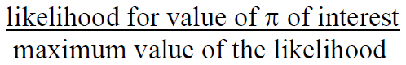
What is pi?
The max likelihood will give you the best point estimate of π, but that isn’t good enough. There needs to be a supported range of where we think the true π is.
Before we can get a supported range we need to move from pure likelihoods to likelihood ratios, which are relative measures on the 0-1 scale (sound familiar?)
Make a new variable in your df for the LR of values of π in this model.

Slide 20
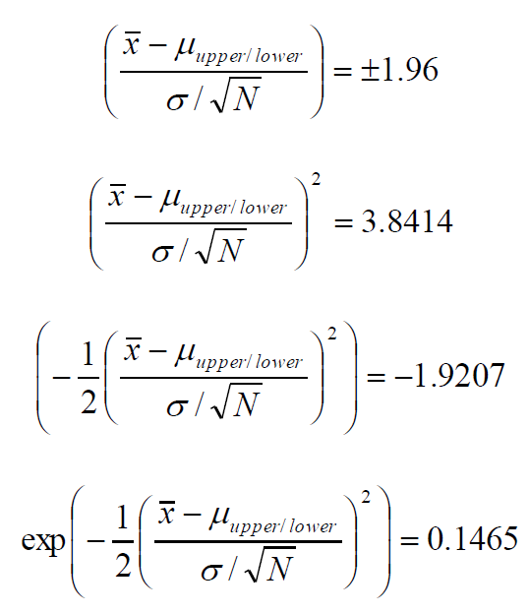
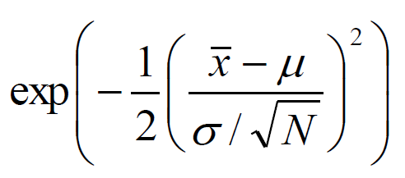
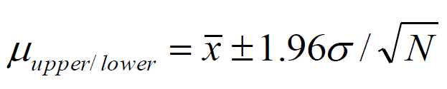
Where to cut off?
0.1465 for likelihood ratio – corresponds to 95%CI
Why?

Slide 21
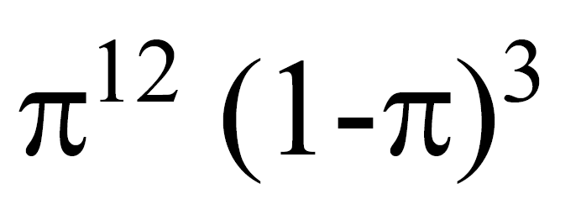
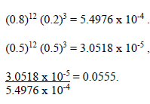
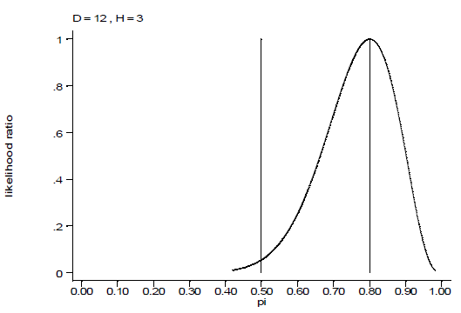
What does this mean?
Testing a null hypothesis
Prob == 0.5 = null
Your prob w/max likelihood = 0.8

Slide 22
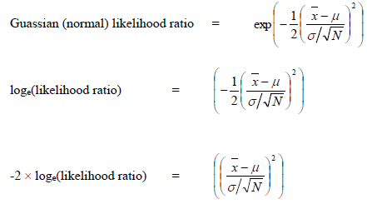
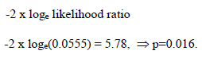

Enough?
You can translate this into a p-value using the following
RHS is the Chi Squared statistic for a N(0,1) distribution

Slide 23
Summary Likelihood
Likelihood quantifies the extent to which data support different values of the parameter of interest
To obtain point estimate of parameter, choose the parameter value which maximises the likelihood
Can also obtain a supported range (confidence interval) by choosing a cut-off for the likelihood ratio and perform statistical significance (hypothesis) tests using the likelihood ratio test.

Slide 24

BUT WAIT
WHAT IF THE UNDERLYING DISTRIBUTION ISN’T PARAMETRIC
WHAT ABOUT THE H0
WHAT ABOUT THE P-VALUES
Lmao idk

Slide 25
